Slide 1
Modeling & Simulation of a Turbojet Engine for Future Commercial Supersonic Transport Utilizing the DEVS-Suite Framework
By Lucio Ortiz and Robert Blazewicz

Slide 2
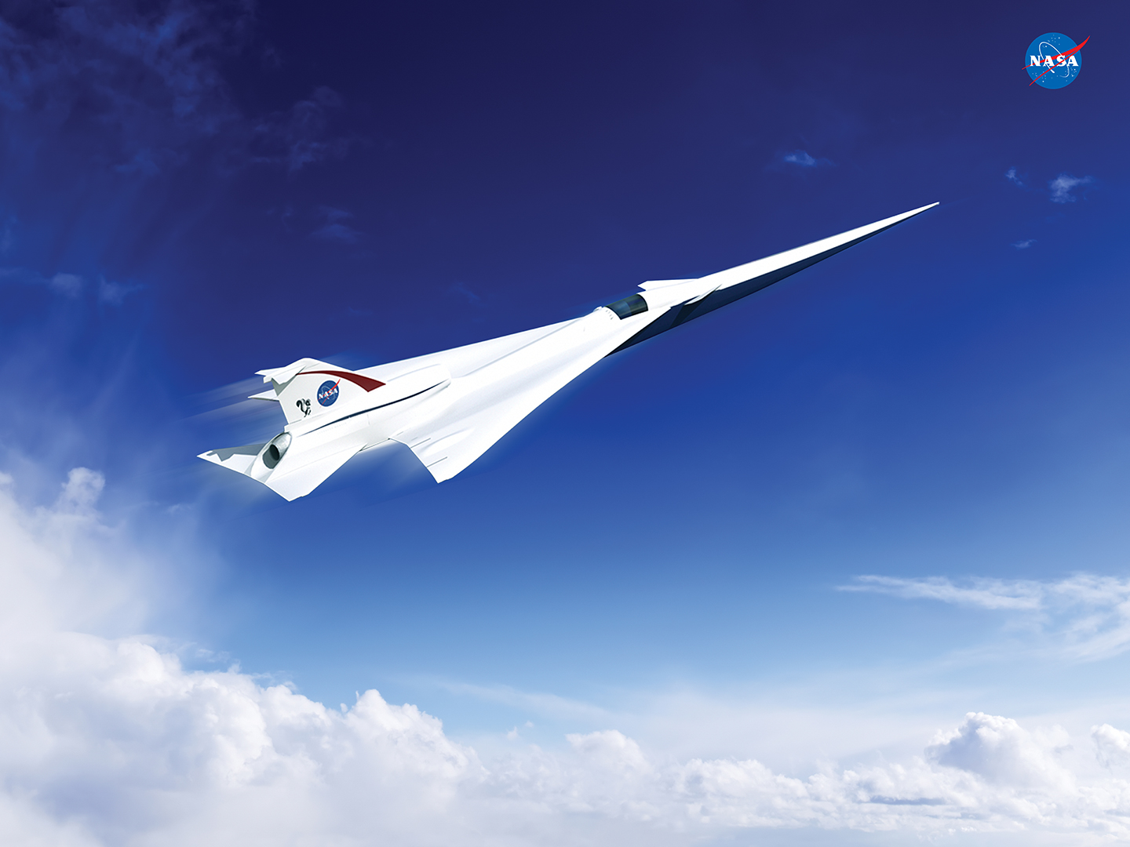
The Future of Supersonic Travel
Image Courtesy of NASA

Slide 3
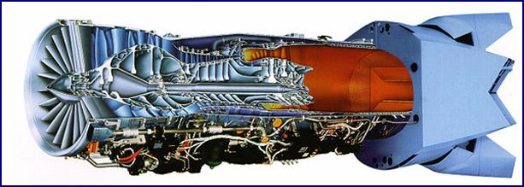
Turbojet Performance and Efficiency

Slide 4
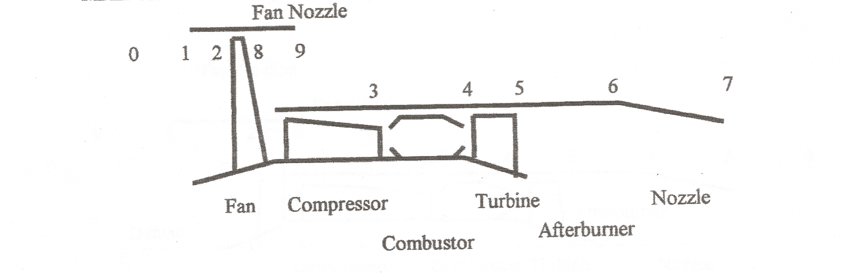
Model Turbojet Components & Stages
System of Systems
Complex, Dynamic
Levels of Abstraction

Slide 5
Modeling a System of Systems:
What do we need to… Model (and Simulate) Complex System of Systems?
System Components:
Functional (Algorithms)
Independent (Loosely Coupled)
System Communications
Interactions between components
Flow of information
System Environment
Realistic Environment
Environmental Variables
Couplings between Environment and Components

Slide 6
Existing Tools
Not Readily Available
Lacking Capability

Slide 7
(Framework) Questions to be Answered:
Can we utilize the DEVS-Suite Framework to model and simulate our Turbojet Engine for Research and Optimization Development?
What framework components will we need to accomplish this goal?
What will our Experimental Frames look like, and how will they need to interact during simulation?

Slide 8
M&S Theory

Slide 9
Levels of System Knowledge
Level | Name | What we know at this Level | Turbojet Simulation
0 | Source | What variables to measure and how to observe them | Thrust Specific Fuel Consumption (TSFC), Specific Thrust output, and Turbojet Efficiencies. Observed through various stages of flight (input Mach #’s), including sustained supersonic speeds.
1 | Data | Data collected from a Source System | Flight data and engine output data from research Comparison of turbojet output measurements with AIAA Simulation Software.
2 | Generative | Means to generate data in a Data System | DEVS Model to recreate engine operation and current and adjusted input flow characteristics.
3 | Structure | Components (at lower levels) coupled together to form a generative system | Turbojet Components Inlet (including Fan) Compressor Combustor Turbine (Afterburner) Nozzle

Slide 10
Fundamental Systems Problems
Systems Problems | Does source of the data exist? What are we trying to learn about it? | Which level transition is involved? | Turbojet Simulation
Systems Analysis | The system being analyzed may exist or may be planned. In either case we are trying to understand its behavioral characteristics. | Moving from higher to lower levels, e.g., using generative information to generate the data in a data system. | Tubojet engines for supersonic flight exist, utilized in military applications. The first step is to attempt a recreation of these engine characteristics and operations under supersonic flight conditions to observe an initial capability baseline.
Systems Inference | The system exists. We are trying to infer how it works from observations of its behavior. | Moving from lower to higher levels, e.g., having data, finding a means to generate it. | We will next try to understand what affects the behaviors of fuel consumption and thrust output during various supersonic flight regimes by adjusting factor (variables) in our model.
Systems Design | The system being designed does not yet exist in the form that is being contemplated. We are trying to come up with a good design for it. | Moving from lower to higher levels, e.g., having a means to generate observed data, synthesizing it with components taken off the shelf. | Finally, our model will provide insight as to the turbojet engine enhancements that may provide for efficient, low-fuel use, commercial supersonic transport aircraft.

Slide 11
A Unified Model and Experiment Designs Structure
Model & Simulation Theory
Model Design
Experimental Framework Design
Model & Simulate Experiments

Slide 12
A Unified Model and Experiment Designs Structure
Model & Simulation Theory
Model Design
Experimental Framework Design
Model & Simulate Experiments

Slide 13
Model Design Strategy
Considering Abstraction Levels
Initial Strategy for the Design of Turbojet Model:
Design basic model for an “Ideal” Turbojet model.
3 System Components with communication framework
Enhance basic design to include more components.
Further design to incorporate “Real” Turbojet conditions.
Isentropic Model, Basic.
Isentropic Model, Complex.
Polytropic Model, Advanced and Enhanced.

Slide 14
Model: System Components
Turbojet Equations –
(Inputs/Outputs & Functions to be Considered for DEVS Framework):

Slide 15
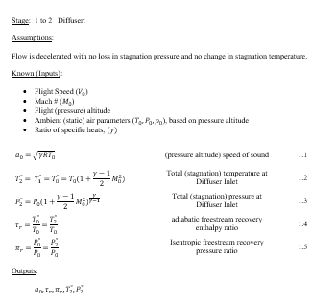
Example: Diffuser

Slide 16
A Unified Model and Experiment Designs Structure
Model & Simulation Theory
Model Design
Experimental Framework Design
Model & Simulate Experiments

Slide 17
Experiment Engine a DEVS Support Infrastructure
Experiment Front Porch
Experiment Models
Experiment
Back Porch
Experiment
Data Recorder

Slide 18
Experiment Engine a DEVS Support Infrastructure
Experiment Front Porch
Experiment Models
Experiment
Back Porch
Experiment
Data Recorder

Slide 19
Experiment Engine a DEVS Support Infrastructure
Experiment Front Porch
Experiment Models
Experiment
Back Porch
Experiment
Data Recorder

Slide 20
Experiment Front Porch the generator
Experiment Front Porch
Experiment Models
Experiment
Back Porch
Load a design experiment
Execute the experiment’s design for each of the models.
Manage starting each experimental run with the appropriate design factors.
Experiment
Data Recorder

Slide 21
Experiment Front Porch the generator
Experiment Front Porch
Experiment Models
Experiment
Back Porch
One design experiment for all models
Multiple factors
Each factor may have different number of levels
No fixed number of runs
Load a design experiment
Execute the experiment’s design for each of the models.
Manage starting each experimental run with the appropriate design factors.
Experiment
Data Recorder

Slide 22
Experiment Front Porch the generator
Experiment Front Porch
Experiment Models
Experiment
Back Porch
List of factors:
"Compressor Pressure Ratio"
variable "pi_c"
Low : 12.2
Med : 15.0
Hi : 17.8
"Afterburner State"
variable "afterburnerOn"
Off : false
On : true
Load a design experiment
Execute the experiment’s design for each of the models.
Manage starting each experimental run with the appropriate design factors.
Experiment
Data Recorder

Slide 23
Experiment Front Porch the generator
Experiment Front Porch
Experiment Models
Experiment
Back Porch
List of experiment runs:
"--" : ["Low", "Off"]
"O-" : ["Med", "Off"]
"+-" : ["Hi", "Off"]
"-+" : ["Low", "On"]
"O+" : ["Med", "On"]
"++" : ["Hi", "On"]
Load a design experiment
Execute the experiment’s design for each of the models.
Manage starting each experimental run with the appropriate design factors.
Experiment
Data Recorder

Slide 24
Experiment Back Porch the accumulator
Experiment Front Porch
Experiment Models
Experiment
Back Porch
Has an experiment run completed?
A model can self-declare that a run is complete.
A model can self-declare that a run has terminated.
Optional user defined method to evaluate run completion state.
Experiment
Data Recorder

Slide 25
Experiment Back Porch the accumulator
Experiment Front Porch
Experiment Models
Experiment
Back Porch
Model A
Has the run completed?
Had the run terminated?
Call user method to calculate if the run has completed.
Model B
Has the run completed?
Had the run terminated?
Call user method to calculate if the run has completed.
Has an experiment run completed?
A model can self-declare that a run is complete.
A model can self-declare that a run has terminated.
Optional user defined method to evaluate run completion state.
Model C
Has the run completed?
Had the run terminated?
Call user method to calculate if the run has completed.
Experiment
Data Recorder

Slide 26
Experiment Data Recorder the transducer
Experiment Front Porch
Experiment Models
Experiment
Back Porch
Export design experiment data for each run.
A model can self-declare that intermediate results of a run be exported.
Export model results when a run is completed or terminated.
Text and CSV output
Experiment
Data Recorder

Slide 27
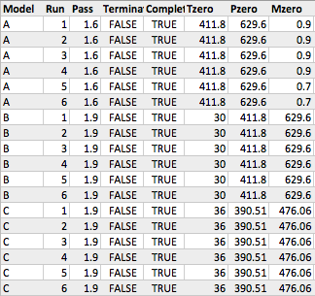
Experiment Data Recorder the transducer
Experiment Front Porch
Experiment Models
Experiment
Back Porch
"<runs>" : [
{"--" : ["Low", "Off"]},
{"O-" : ["Med", "Off"]},
{"+-" : ["Hi", "Off"]},
{"-+" : ["Low", "On"]},
{"O+" : ["Med", "On"]},
{"++" : ["Hi", "On"]}
]
Export design experiment data for each run.
A model can self-declare that intermediate results of a run be exported.
Export model results when a run is completed or terminated.
Text and CSV output
Experiment
Data Recorder

Slide 28
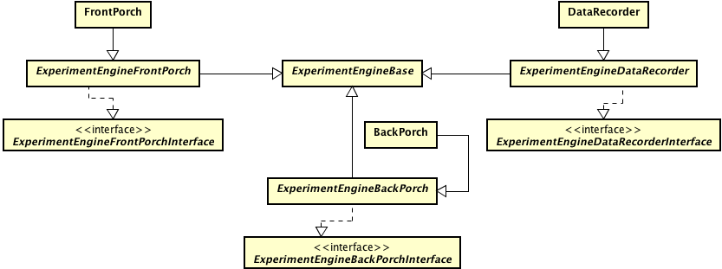
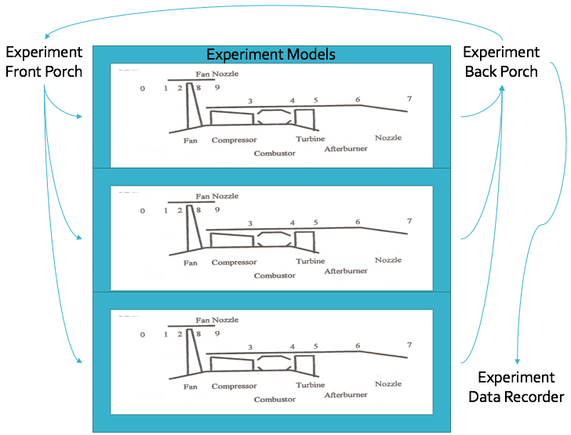

Slide 29
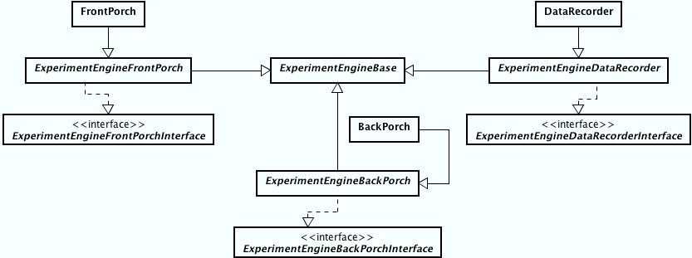
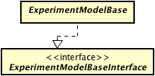

Slide 30
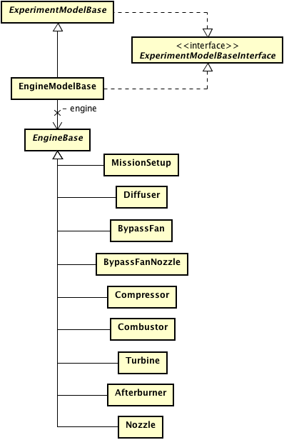

Slide 31
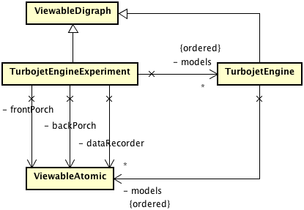
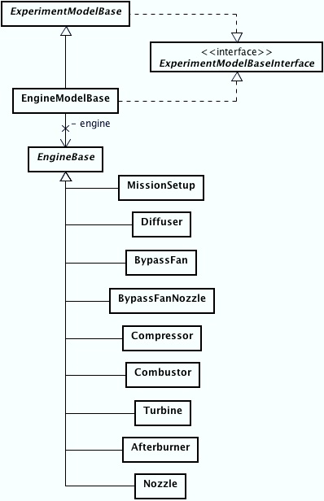

Slide 32
A Unified Model and Experiment Designs Structure
Model & Simulation Theory
Model Design
Experimental Framework Design
Model & Simulate Experiments

Slide 33
Verification & Validation
Verification: Did we build the product right?
3 Part (Model) Verification
Hand Calculations
AIAA Calculations
DEVS Turbojet Calculations
Validation: Did we build the right product?
Does it simulate our complex System of Systems?
Can we use it in the way we want to?

Slide 34
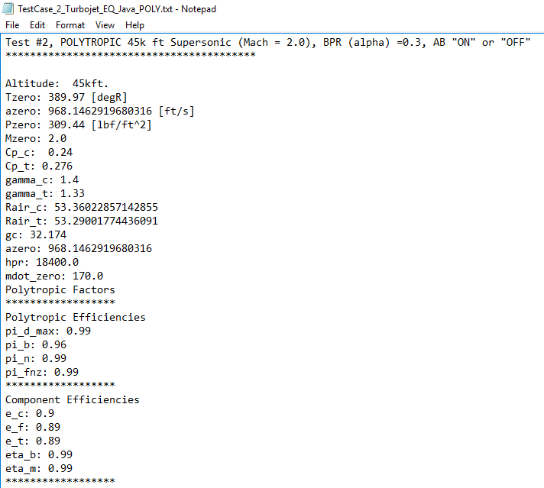
Verification & Validation: Example Test Case

Slide 35
Verification
3 Models verified
Isentropic/Subsonic
Isentropic/Supersonic
Polytropic/Supersonic

Slide 36
DEVS vs. AIAA
Isentropic/Static/Subsonic (BPR=0, AB=Off)

Slide 37
DEVS vs. AIAA
Isentropic/Static/Supersonic (BPR=0, AB=ON & Off)

Slide 38
DEVS vs. AIAA
Polytropic/Supersonic

Slide 39
Validation
Many Experimental Runs Complete
(At least) 3 Models Simultaneously
Over 50 runs at a time with variable alterations
Calibration Feature
Models are Independent of Framework

Slide 40
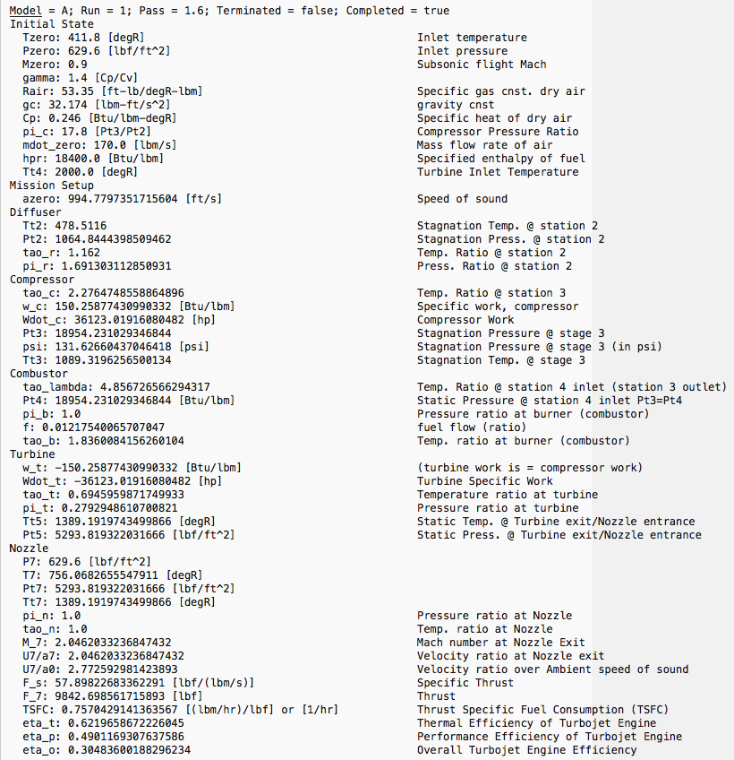

Slide 41
Example Data

Slide 42
Example Data

Slide 43
Continuing Work with DEVS-Framework

Slide 44
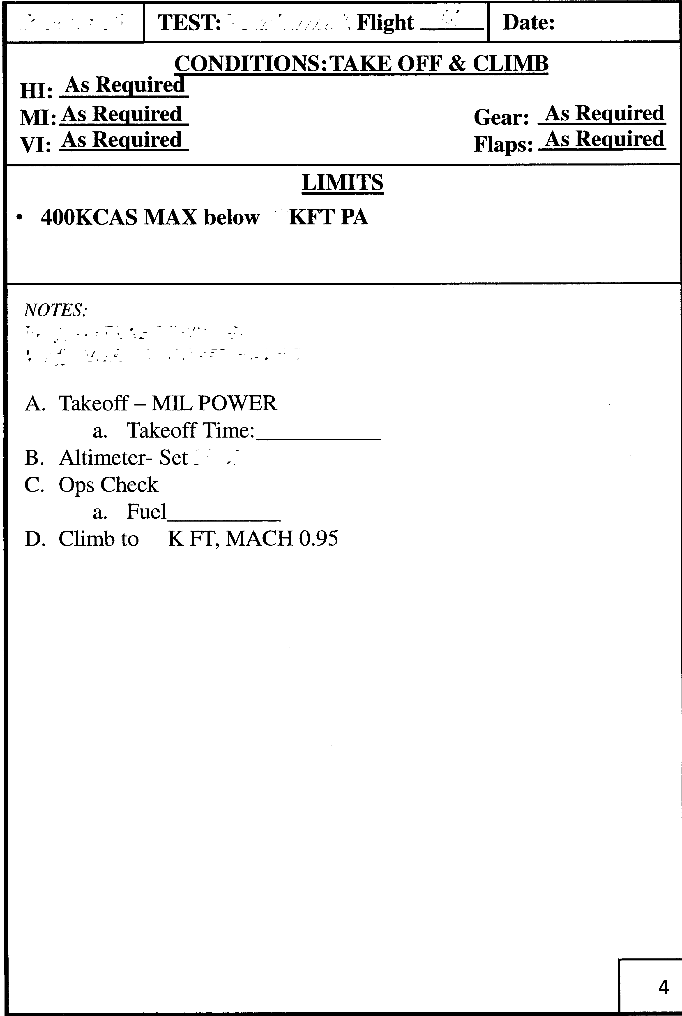
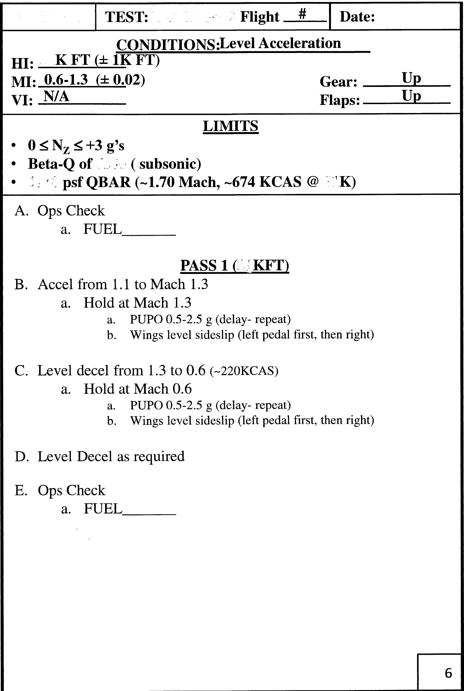
Full Flight Regime: Sample Test Flight

Slide 45

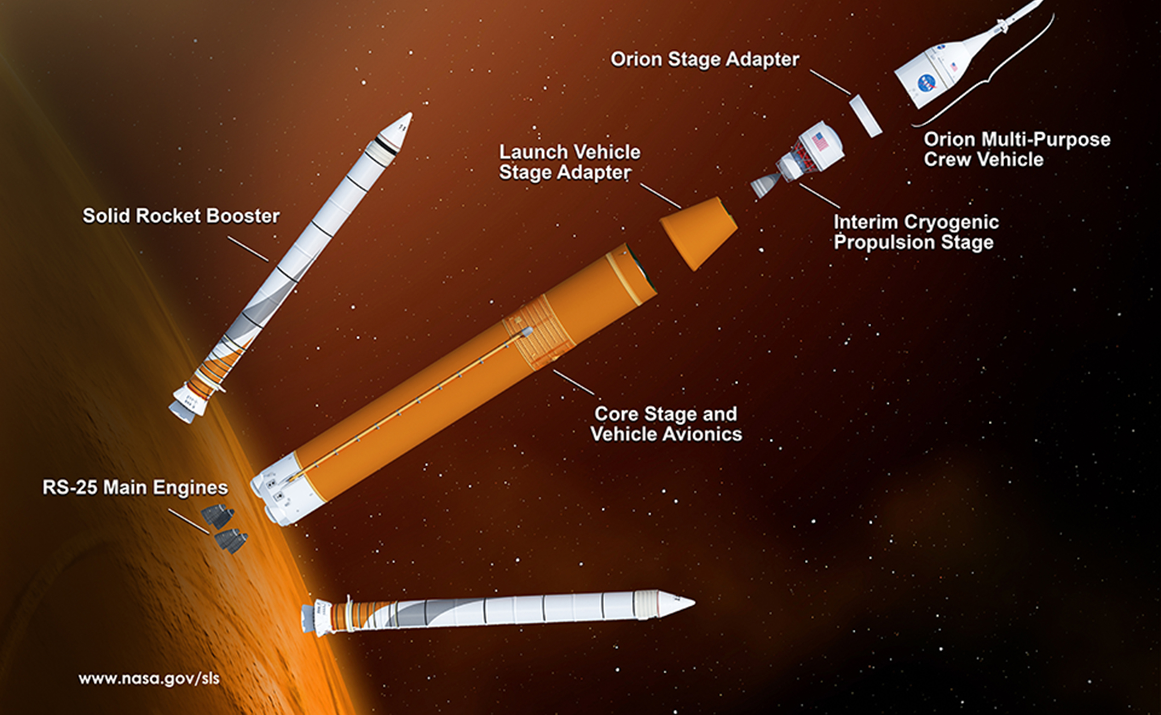
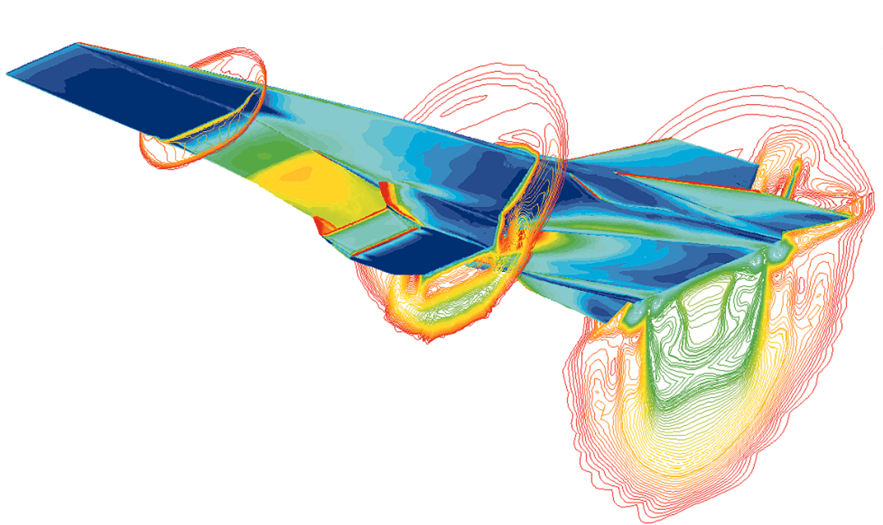
Tomorrow… and Beyond!

Slide 46
Questions?

Slide 47
Experiment Engine a Development Plan
Lofty vision
Elaborate project plan for the Turbojet Engine
Our project plan was like a traditional startup business plan. A solution for a fictitious customer that quickly dies as soon as the product receives actual customer feedback.
10-weeks to develop project
Defining the experiment engine took about 3-weeks leaving 6-weeks to reach a near final implementation.
Lot of pressure to develop a useful tool for both the Turbojet Engine and the general DEVS Suite.
Lots of uncertainty with the design path, and significant upfront chaos.
Our approach:
Lean development process to develop a minimal viable product.
Rapid incremental prototyping based on customer feedback.
Customers: Lucio Ortiz and Professor Sarjoughian
Use of Lean methodology
Goal and milestones structured within 2-week Scrum sprints

Slide 48
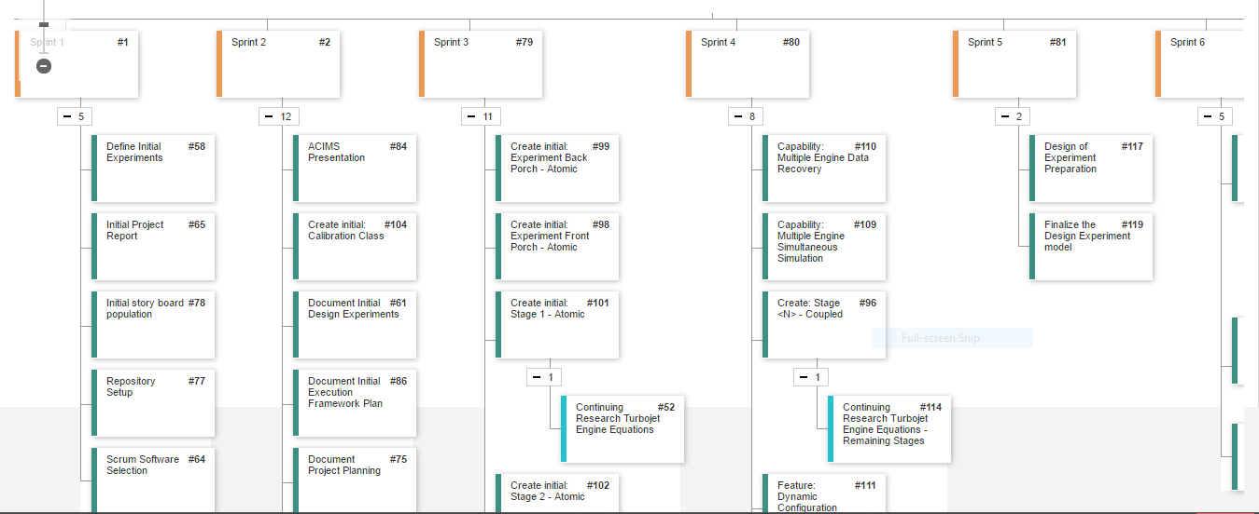
Experiment Engine a Development Plan
Sprint Board

Slide 49
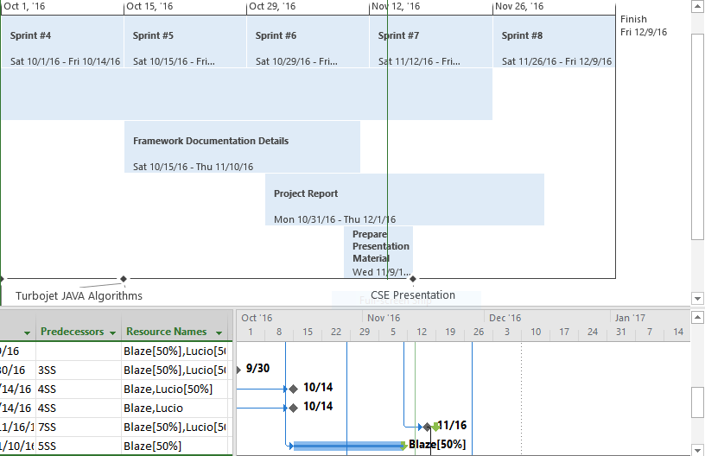
Experiment Engine a Development Plan
Microsoft Project

Slide 50
M&S/Design of Experiments
A Systematic, Flexible, and Repeatable Process

Slide 51
R&D Problem
What effect does the pressure compression ratio in the compressor stage have on the performance of the turbojet engine, during long-duration, supersonic flight?
Can we eliminate the use of a Hi-Bypass (ratio) fan, in exchange for either a Low-Bypass (ratio) or (straight) turbojet engine, for additional propulsion, and still meet thrust and fuel requirements for long-duration supersonic flight? (without the use of afterburner)
What effect does decreasing the limitations/constraints of the Turbine Inlet temperature offer for the turbojet performance during long-duration supersonic flight? (i.e. Increasing the allowable temperature by use of new, high tolerance materials or designs)
If the above parameters show a significant effect on the turbojet performance, is there a combination of pressure compression ratio, (low) by-pass ratio, and turbine inlet temperature that would optimize turbojet performance during long-duration, supersonic flight?
(Initial Model) Questions to be Answered:

Slide 52
Ambitious (Optional) Questions:
Is there any insight as to what may be necessary to re-design a turbojet engine to allow the extraction of a significant amount of (auxiliary) power, for use in hi-power payload packages?
Can we predict what properties a fuel might need to have in order to offer an existing turbojet design, significantly more thrust than traditional jet fuel?

Slide 53
Design of Experiments
Initial Design of Experiments:
Phase I – Initialization, Verification & Validation of Model
Simulate “Ideal” Turbojet model with all static input values for a baseline verification and validation of basic model.
Simulate “Ideal” Turbojet model with various levels of pressure compression ratio for verification and validation of changing variable experimentation.
Simulate “Ideal” Turbojet model with afterburner, static input values.
Simulate “Ideal” Turbojet model with by-pass ratio fan, static input values.
Simulate “Real” Turbojet model with afterburner and by-pass ratio fan, static values.
Phase I

Slide 54
Design of Experiments
Phase II – Design of Experiments for Analysis
Fractional Factorial Experiment:
4 Factors
Pressure Compression Ratio
By Pass Ratio (BPR)
Turbine Inlet Temperature
Afterburner
2 Levels, (Each Factor)
Pressure Compression Ratio (Low, Hi)
BPR (Low, Hi)
Turbine Inlet Temperature (Low, Hi)
Afterburner (On, Off)
Phase II

Slide 55
Design of Experiments: Phase II: Fractional Factorial
Turbojet Experiment Set 01: 16 runs
Column1 | pi_c | alpha | Tt4 | Afterburner | eta_o | eta_p | eta_t | F | F_s | TSFC
1 | 24.25 | 1 | 2400 | ON
2 | 13.5 | 1 | 3600 | OFF
3 | 24.25 | 0 | 2400 | OFF
4 | 13.5 | 2 | 1200 | OFF
5 | 13.5 | 0 | 3600 | ON
6 | 24.25 | 2 | 2400 | OFF
7 | 13.5 | 2 | 3600 | ON
8 | 35 | 2 | 3600 | OFF
9 | 24.25 | 2 | 1200 | ON
10 | 35 | 1 | 1200 | OFF
11 | 13.5 | 0 | 1200 | OFF
12 | 13.5 | 1 | 1848 | ON
13 | 35 | 2 | 2400 | ON
14 | 35 | 0 | 1200 | ON
15 | 27.045 | 1 | 3600 | ON
16 | 35 | 0 | 3600 | OFF
Randomized Model with Replicate

Slide 56
Design of Experiments
(Possible) Phase III – Design of Experiments for Optimization
Based on findings from Phase II:
Are there optimal levels of the variables which offer the greatest potential of performance enhancement?
Creation of Randomized ‘Optimal’ Design of Experiments with continuous levels for factor variables
Phase II

Slide 57
Design of Experiments: Fractional Factorial Results
Turbojet Experiment Set 01: 16 runs
Column1 | pi_c | alpha | Tt4 | Afterburner | eta_o | eta_p | eta_t | F | F_s | TSFC
1 | 24.25 | 1 | 2400 | ON | 0.23 | 0.70 | 0.32 | 6368.69 | 37.46 | 2.93
2 | 13.5 | 1 | 3600 | OFF | 0.41 | 0.67 | 0.60 | 9219.11 | 54.23 | 1.17
3 | 24.25 | 0 | 2400 | OFF | 0.34 | 0.82 | 0.42 | 5151.46 | 30.30 | 1.35
4 | 13.5 | 2 | 1200 | OFF | 0.00 | 0.00 | 0.00 | 0.00 | 0.00 | 0.00
5 | 13.5 | 0 | 3600 | ON | 0.28 | 0.52 | 0.54 | 21703.27 | 127.67 | 1.72
6 | 24.25 | 2 | 2400 | OFF | 0.23 | 0.44 | 0.53 | 1524.03 | 8.96 | 1.52
7 | 13.5 | 2 | 3600 | ON | 0.37 | 0.63 | 0.58 | 9508.49 | 55.93 | 1.31
8 | 35 | 2 | 3600 | OFF | 0.51 | 0.78 | 0.65 | 6059.31 | 35.64 | 0.92
9 | 24.25 | 2 | 1200 | ON | 0.00 | 0.00 | 0.00 | 0.00 | 0.00 | 0.00
10 | 35 | 1 | 1200 | OFF | 0.00 | 0.00 | 0.00 | 0.00 | 0.00 | 0.00
11 | 13.5 | 0 | 1200 | OFF | 0.00 | 0.00 | 0.00 | 0.00 | 0.00 | 0.00
12 | 13.5 | 1 | 1848 | ON | 0.14 | 0.83 | 0.17 | 5728.87 | 33.70 | 3.25
13 | 35 | 2 | 2400 | ON | 0.00 | 0.00 | 0.00 | 0.00 | 0.00 | 0.00
14 | 35 | 0 | 1200 | ON | 0.00 | 0.00 | 0.00 | 0.00 | 0.00 | 0.00
15 | 27.045 | 1 | 3600 | ON | 0.33 | 0.57 | 0.57 | 12727.58 | 74.87 | 1.46
16 | 35 | 0 | 3600 | OFF | 0.38 | 0.63 | 0.60 | 13316.15 | 78.33 | 1.26

Slide 58
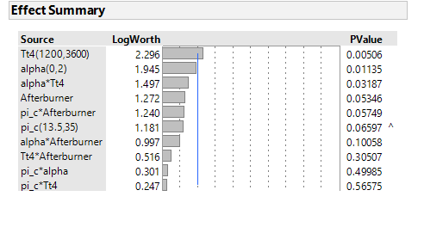
Effect Summary
JMP Effect Screening

Slide 59
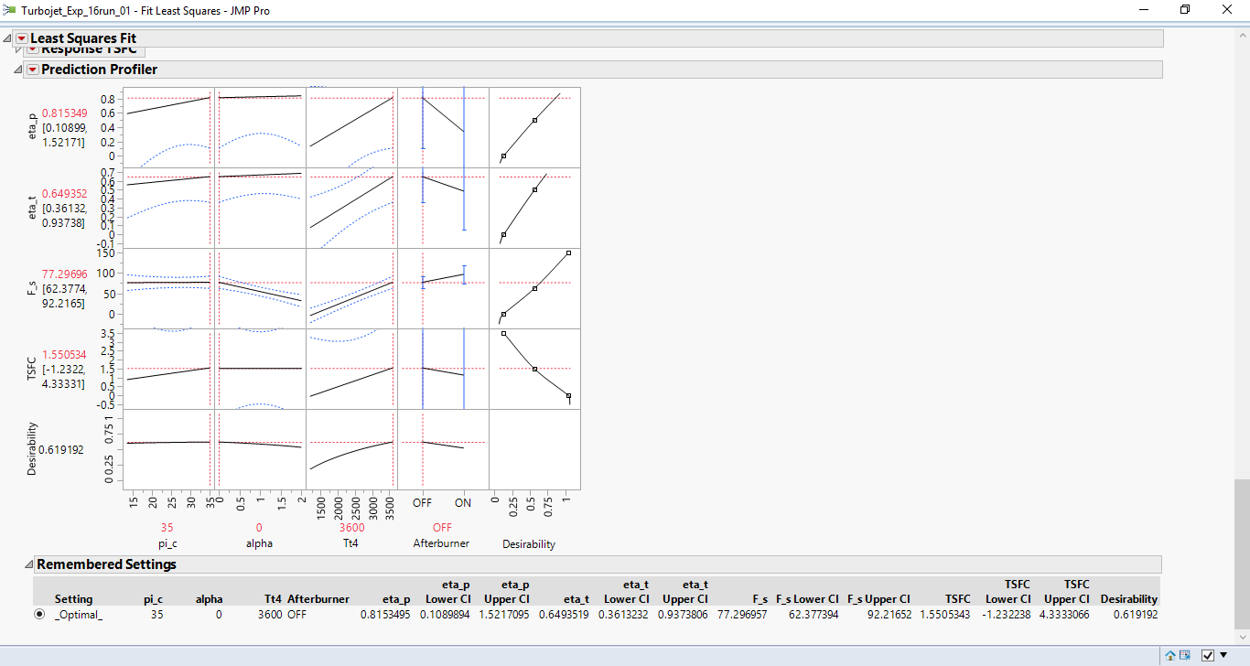
Effect Summary
Optimization:
Maximize Desireability:
Max Efficiency
Max Thrust
Minimize Fuel Flow

Slide 60
Factor Insight
What are the behaviors over the span of operation?

Slide 61
Factor Insight
What are the behaviors over the span of operation?

Slide 62
Factor Insight
What are the behaviors over the span of operation?

Slide 63
Factor Insight
What are the behaviors over the span of operation?

Slide 64
Factor Insight
Similarly for other Factors

Slide 65
Configuration Support via Calibration & Value Management
Experiment Front Porch
Experiment
Back Porch
Model Calibration
Experiment Models
Value Management
Experiment
Data Recorder

Slide 66
Model Calibration
Model Calibration
Experiment Front Porch
Experiment
Back Porch
Class constants:
KeTJET_DDa_VelocityJerk
^^^
second derivative of acceleration
Redefine model constants at runtime.
Each experiment model has it’s own calibration settings.
High level external control of parameters that define a model.
Value Management
Experiment
Data Recorder

Slide 67
Model Calibration
Model Calibration
Experiment Front Porch
Experiment
Back Porch
Class constants:
KeTJET_DDa_VelocityJerk
^^^
second derivative of acceleration
K[e|a][A-Z0-1]+_<type>_<name>
K : calibration variable e|a : element or array part : component name acronym type : a defined type name : variable name
Redefine model constants at runtime.
Each experiment model has it’s own calibration settings.
High level external control of parameters that define a model.
Value Management
Experiment
Data Recorder

Slide 68
Model Calibration
Model Calibration
Experiment Front Porch
Experiment
Back Porch
Class constants:
KeTJET_DDa_VelocityJerk
^^^
second derivative of acceleration
Type definitions:
boolean : "Bool" char : byte : short : int : "Cnt", "ms" long : float : double : "a", "Da", "DDa" String : "Str"
Redefine model constants at runtime.
Each experiment model has it’s own calibration settings.
High level external control of parameters that define a model.
Value Management
Experiment
Data Recorder

Slide 69
Model Calibration
Model Calibration
Experiment Front Porch
Experiment
Back Porch
Class constants:
KeTJET_DDa_VelocityJerk
^^^
second derivative of acceleration
"KeTJET_DDa_VelocityJerk" : "0.35"
"KeTJET_Bool_Afterburner" : "false"
"KeTJET_Cnt_SimViewRows" : "2"
"KeTJET_Str_FluidModel" : "Isentropic/Static (subsonic)"
Redefine model constants at runtime.
Each experiment model has it’s own calibration settings.
High level external control of parameters that define a model.
Value Management
Experiment
Data Recorder

Slide 70
Value Management
Value Management
Experiment Front Porch
Experiment
Back Porch
Your model class:
Define initial values externally
Declare class variables
Code focuses on using values rather than packing / unpacking values from modeling link structure
An efficient way to manipulate model values.
Value Management
Experiment
Data Recorder

Slide 71
Value Management
Value Management
Experiment Front Porch
Experiment
Back Porch
Define initial value externally
"Tzero" : "double", "411.8", "[degR]", "Inlet temperature" "gamma" : "double", "1.4", "[Cp/Cv]", "Specific Heat Ratio of air " "Rair" : "double", "53.35", "[ft-lb/degR-lbm]", "Specific gas cnst. dry air" "gc" : "double", "32.174", "[lbm-ft/s^2]", "gravity cnst"
An efficient way to manipulate model values.
Value Management
Experiment
Data Recorder

Slide 72
Value Management
Value Management
Experiment Front Porch
Experiment
Back Porch
Declare class variables
/* Inputs */ private double Tzero; private double gamma; private double Rair; private double gc; /* Outputs */ private double azero;
An efficient way to manipulate model values.
Value Management
Experiment
Data Recorder

Slide 73
Value Management
Value Management
Experiment Front Porch
Experiment
Back Porch
Code focus
public void process(final ValueSet valueSet) { valueSet.valuePop(this); // [ft/s] speed of sound azero = Math.sqrt(gamma*Rair*gc*Tzero); if (valueSet.isFirstPass()) valueSet.addValue(name, "azero", Value.theType.eDouble, azero, "[ft/s]", "Speed of sound"); valueSet.valuePush(this); }
An efficient way to manipulate model values.
Value Management
Experiment
Data Recorder

Slide 74
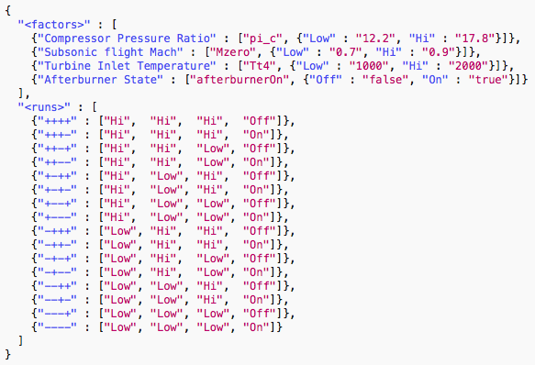

Slide 75
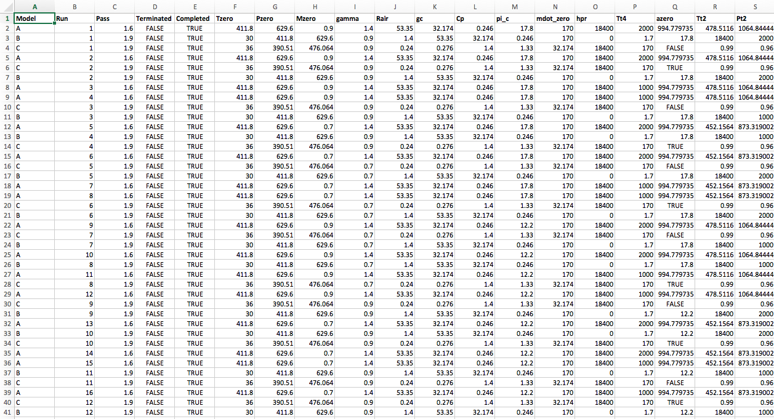

Slide 76
DEVS vs. AIAA
Isentropic/Static/Subsonic (BPR=0, AB=Off)

Slide 77
DEVS vs. AIAA
Isentropic/Static/Subsonic (BPR=0, AB=Off)

Slide 78
DEVS vs. AIAA
Polytropic/Supersonic

Slide 79
DEVS vs. AIAA
Polytropic/Supersonic

